Slide 1
IoT Workshop
Presented by Nextingo

Slide 2
Introduction To IoT
What is IoT ?
IoT or Internet of things refers to the connectivity of the devices and machines through the internet.
This allows seamless exchange of data between devices leading to improves efficiency and automation.
Main applications include manufacturing, healthcare and smart homes

Slide 3
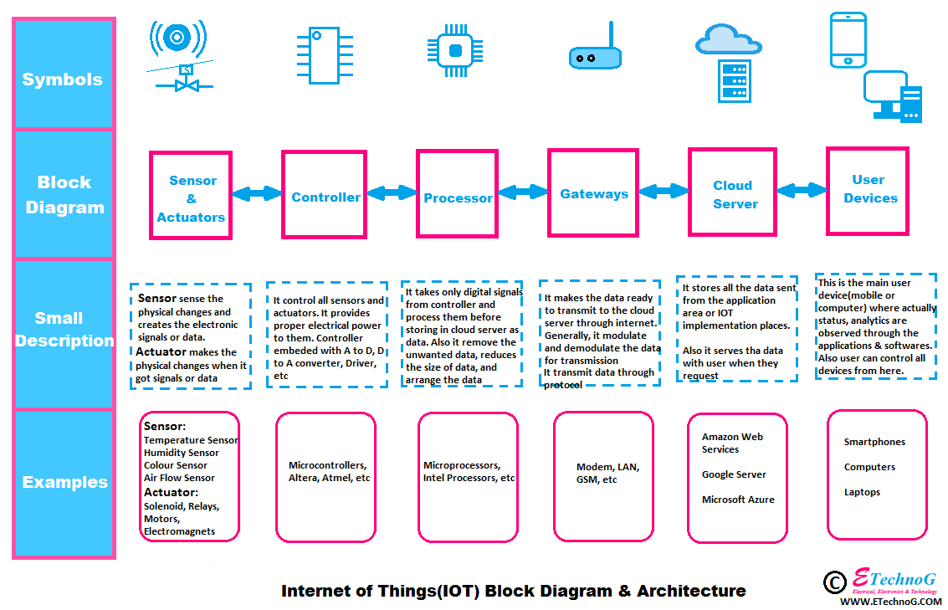

Slide 4
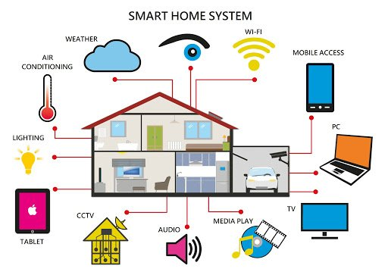

Slide 5

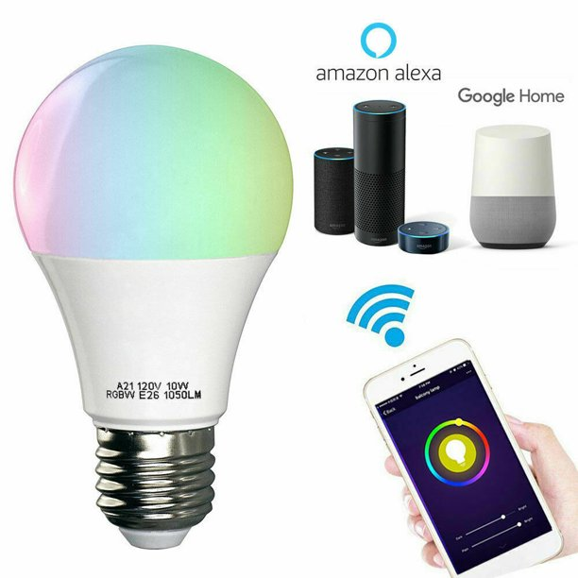
Home automation products in indian market right now

Slide 6
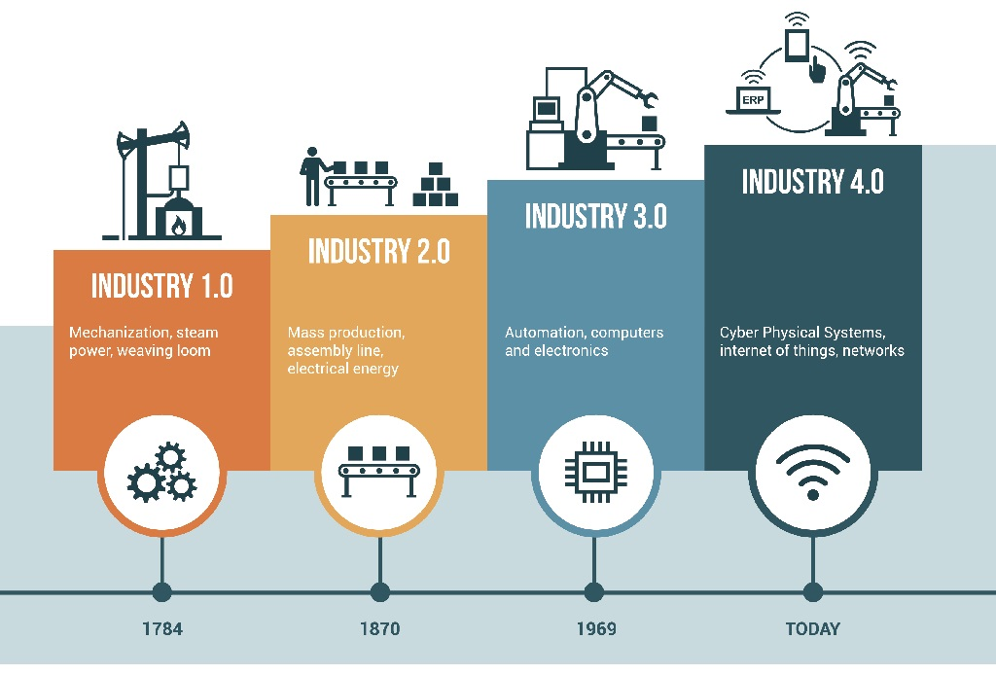
Industrial Automation so far

Slide 7
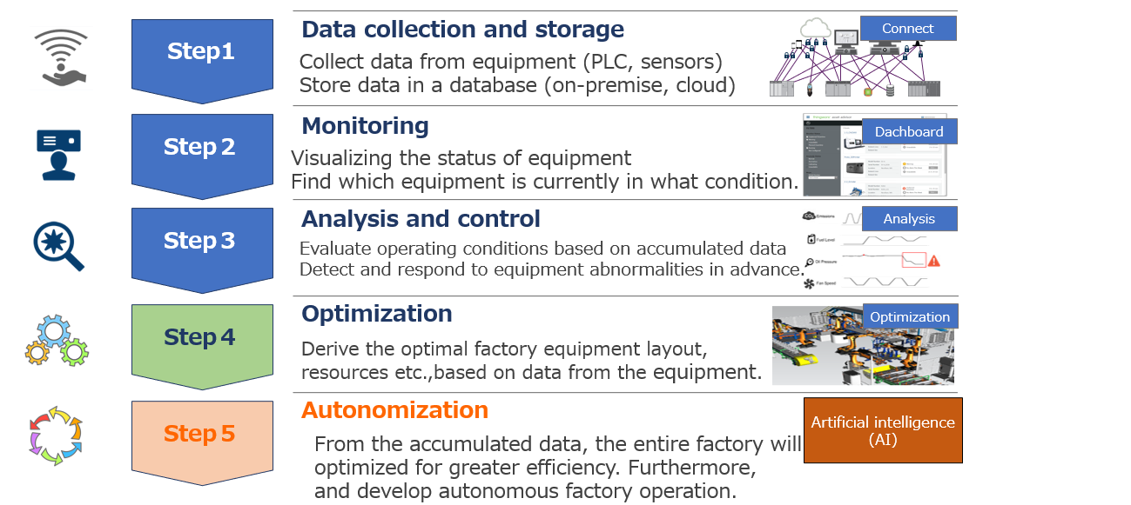
Purpose Of Industrial Automation 4.0

Slide 8
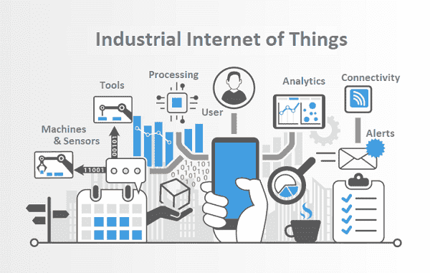
Industrial Automation 4.0

Slide 9
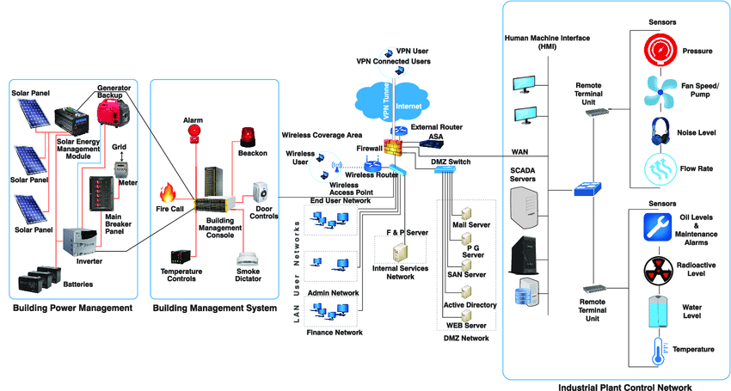
Components of IoT in industry 4.0

Slide 10
NodeMCU
What is NodeMCU?
Its Open Source development platform.
Low cost, easy to use.
Inbuilt Wifi
It Supports many languages as Arduino IDE, Micro Python and LUA

Slide 11
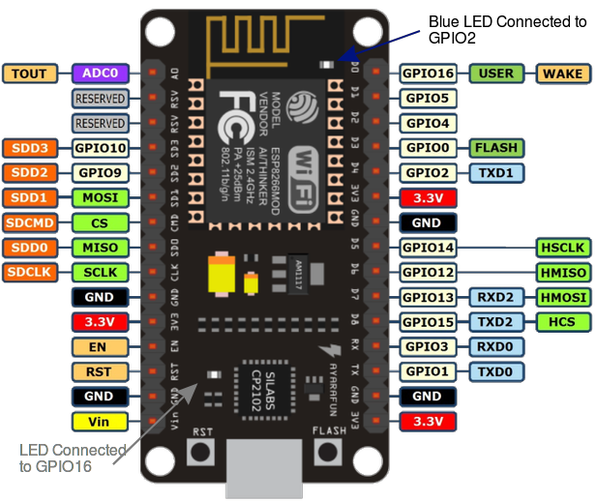
NodeMCU Module

Slide 12
Features of NodeMCU
32-bit RISC Microcontroller
Built-In WiFi
3.3v Operating Voltage
16 I/O Pins
1 ADC
1 Serial Port
1 SPI, 1 I2C Port
4MB Flash Memory
64KB SRAM
80MHz CLock Speed

Slide 13
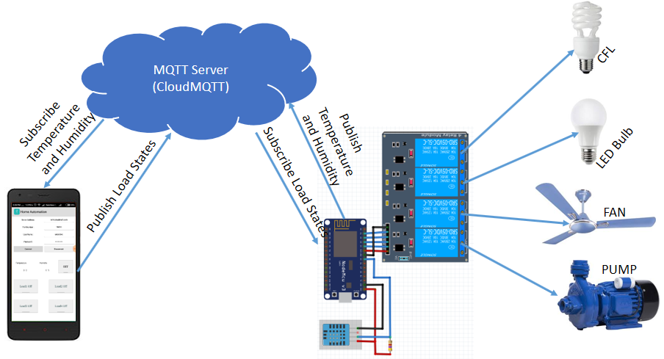
NodeMCU Working

Slide 14
Things Covered in Workshop
Introduction to IoT
Introduction to NodeMCU
NodeMCU Hardware and software
IoT Protocols
Introduction to cloud services
Sensors and other input devices
Actuators
Displays

Slide 15
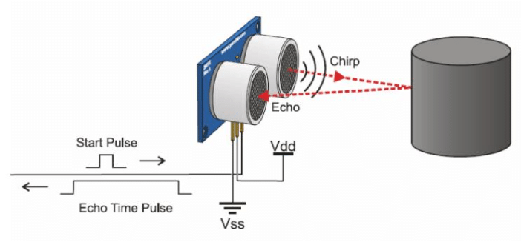
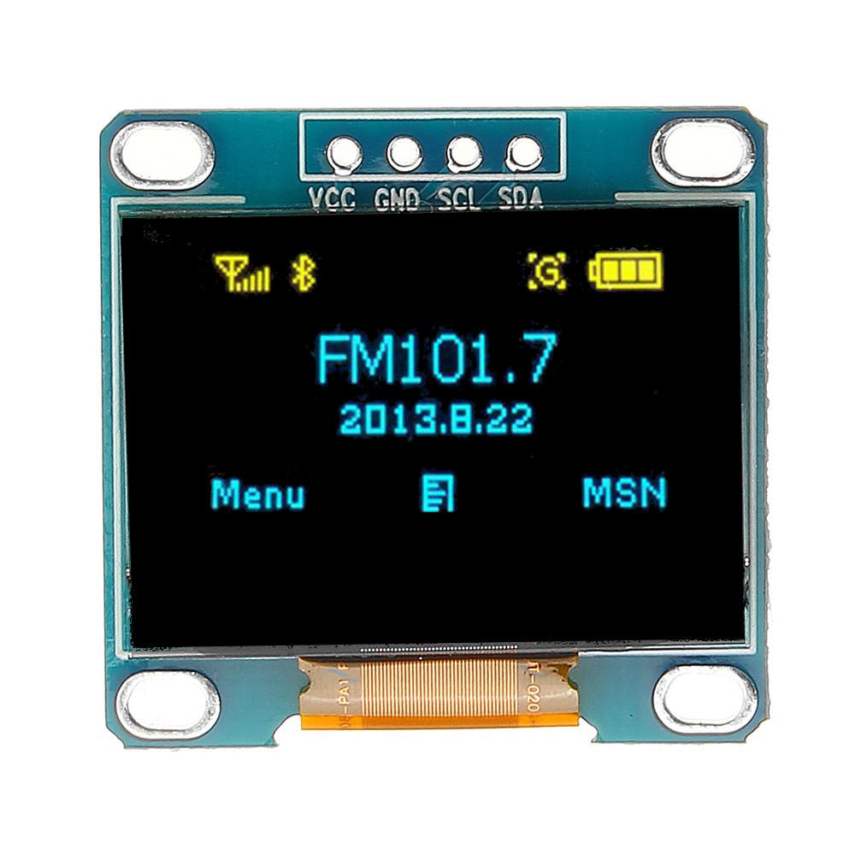
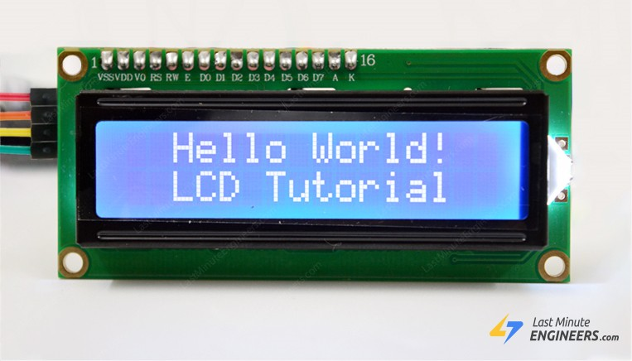
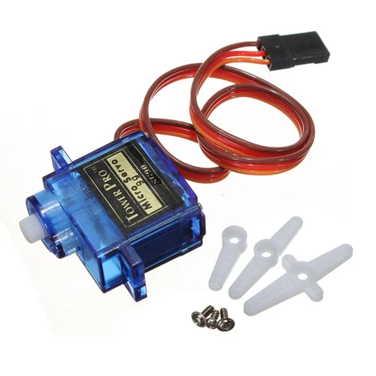
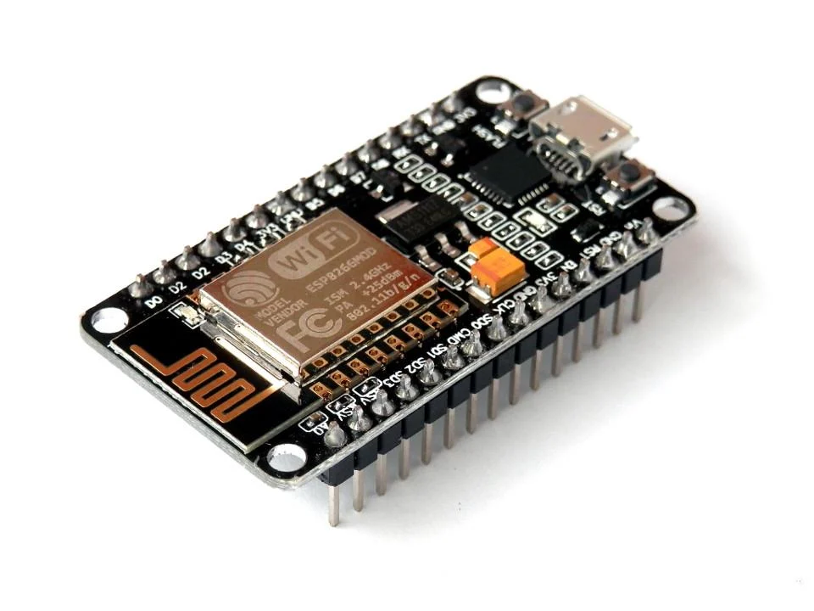
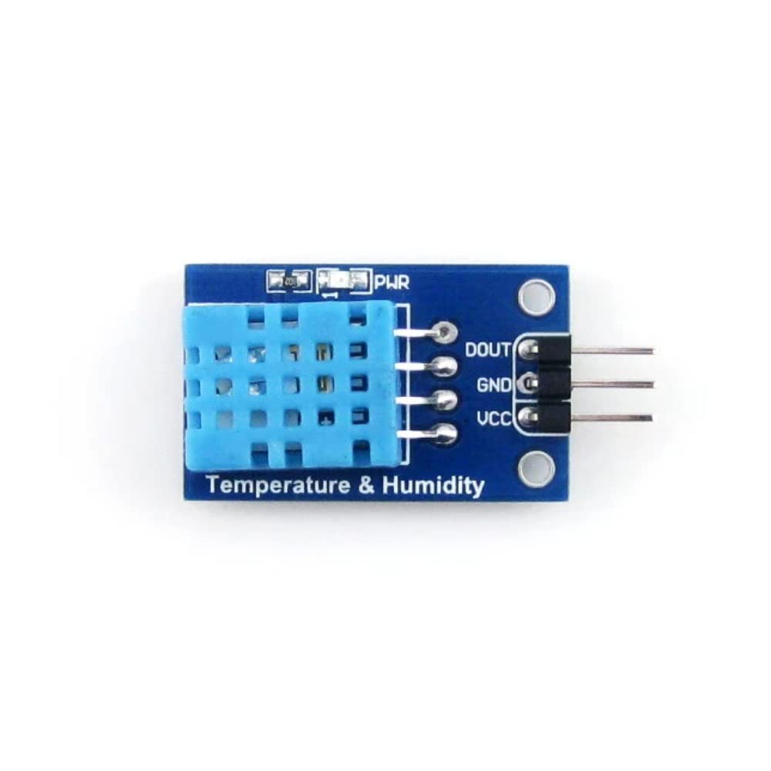
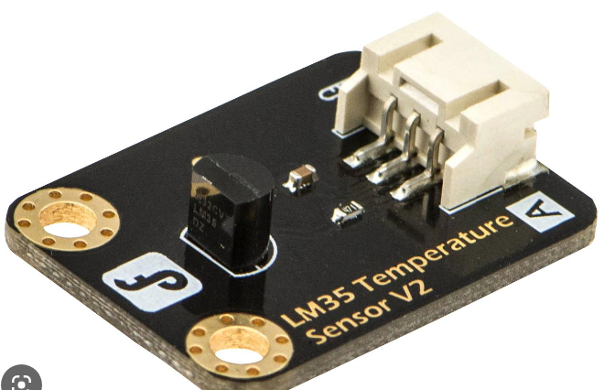
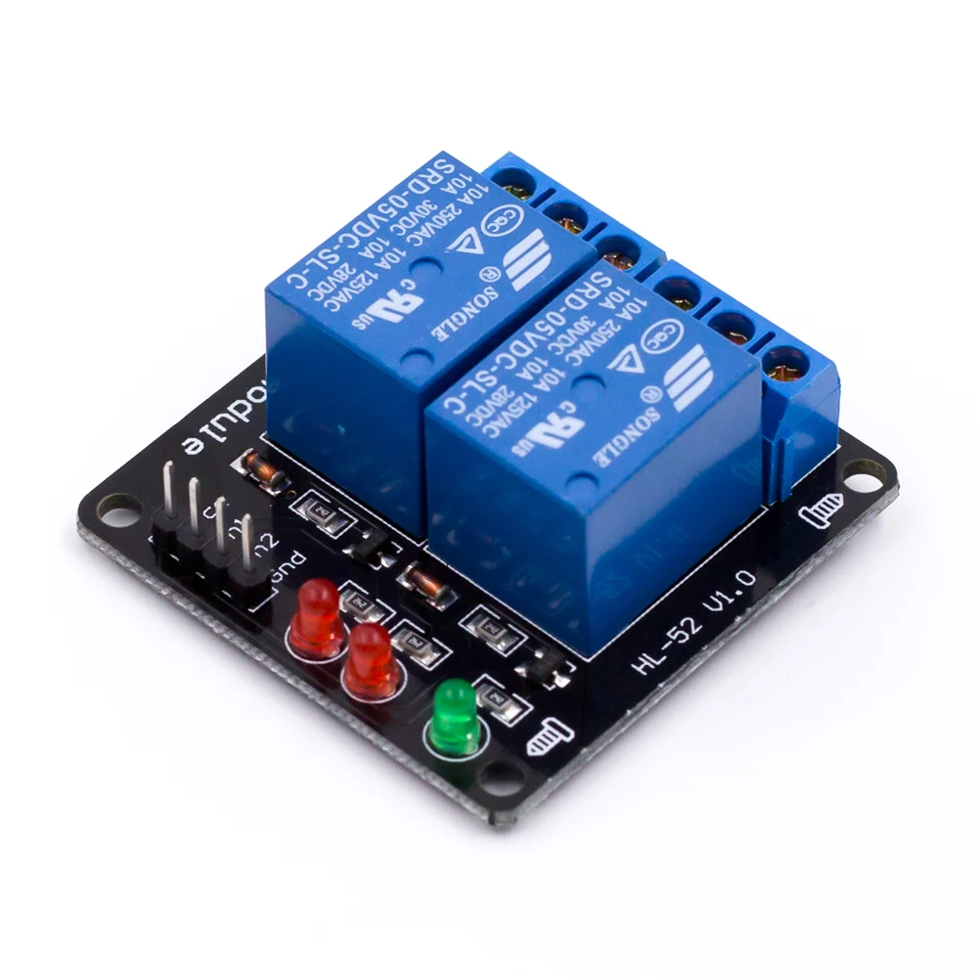
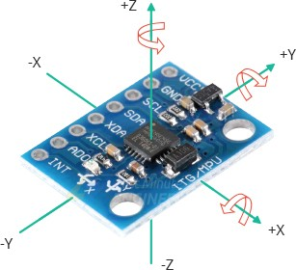
Components

Slide 16
Projects
Home Automation
Weather Reporting System
Health Monitoring System
Alarm System

Slide 17
Thank You

